Slide 1

ICS Light Cubes
Modular Illumination Ecosystem
Presenter: Harley Bondini
ICS Light Cubes: A reconfigurable lighting solution designed
for adaptive environments. Its scalable form factor allows transition
from a single task light to linear arrays in seconds.

Slide 2

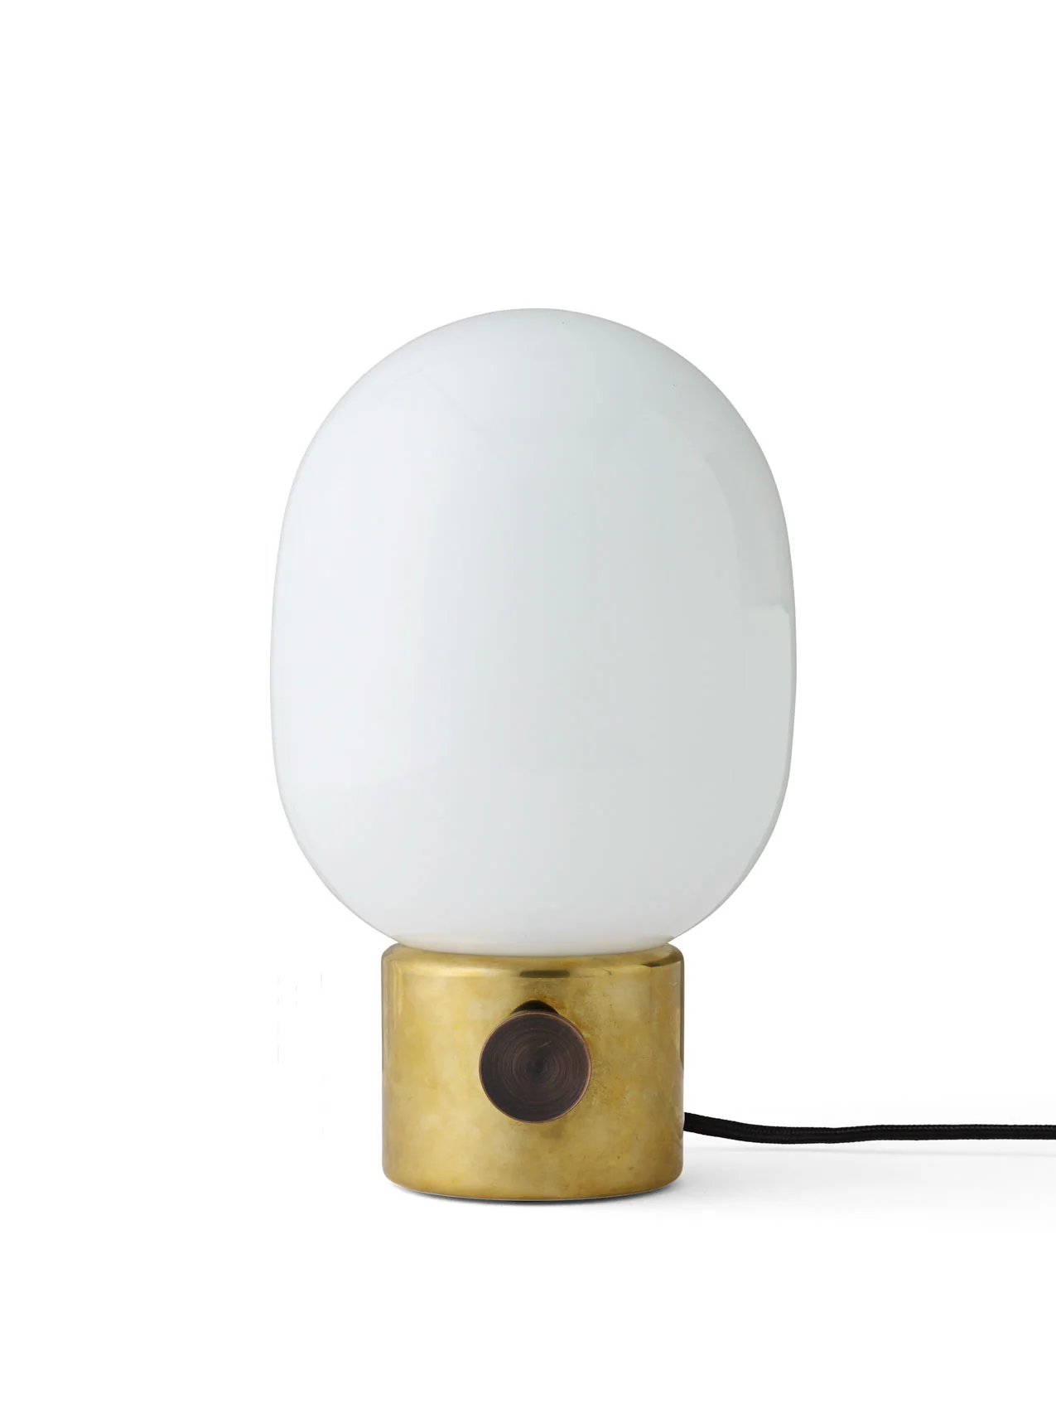

The Limitations of Static Home Lighting
Overhead Lighting
Traditional Ambient Solutions
Portable Options
Often creates an intense and stimulating environment through excessive brightness.
Lamps remain restricted by power cords and fixed locations.
Hampered by charging requirements and rarely blend naturally with modern decor.

Slide 3

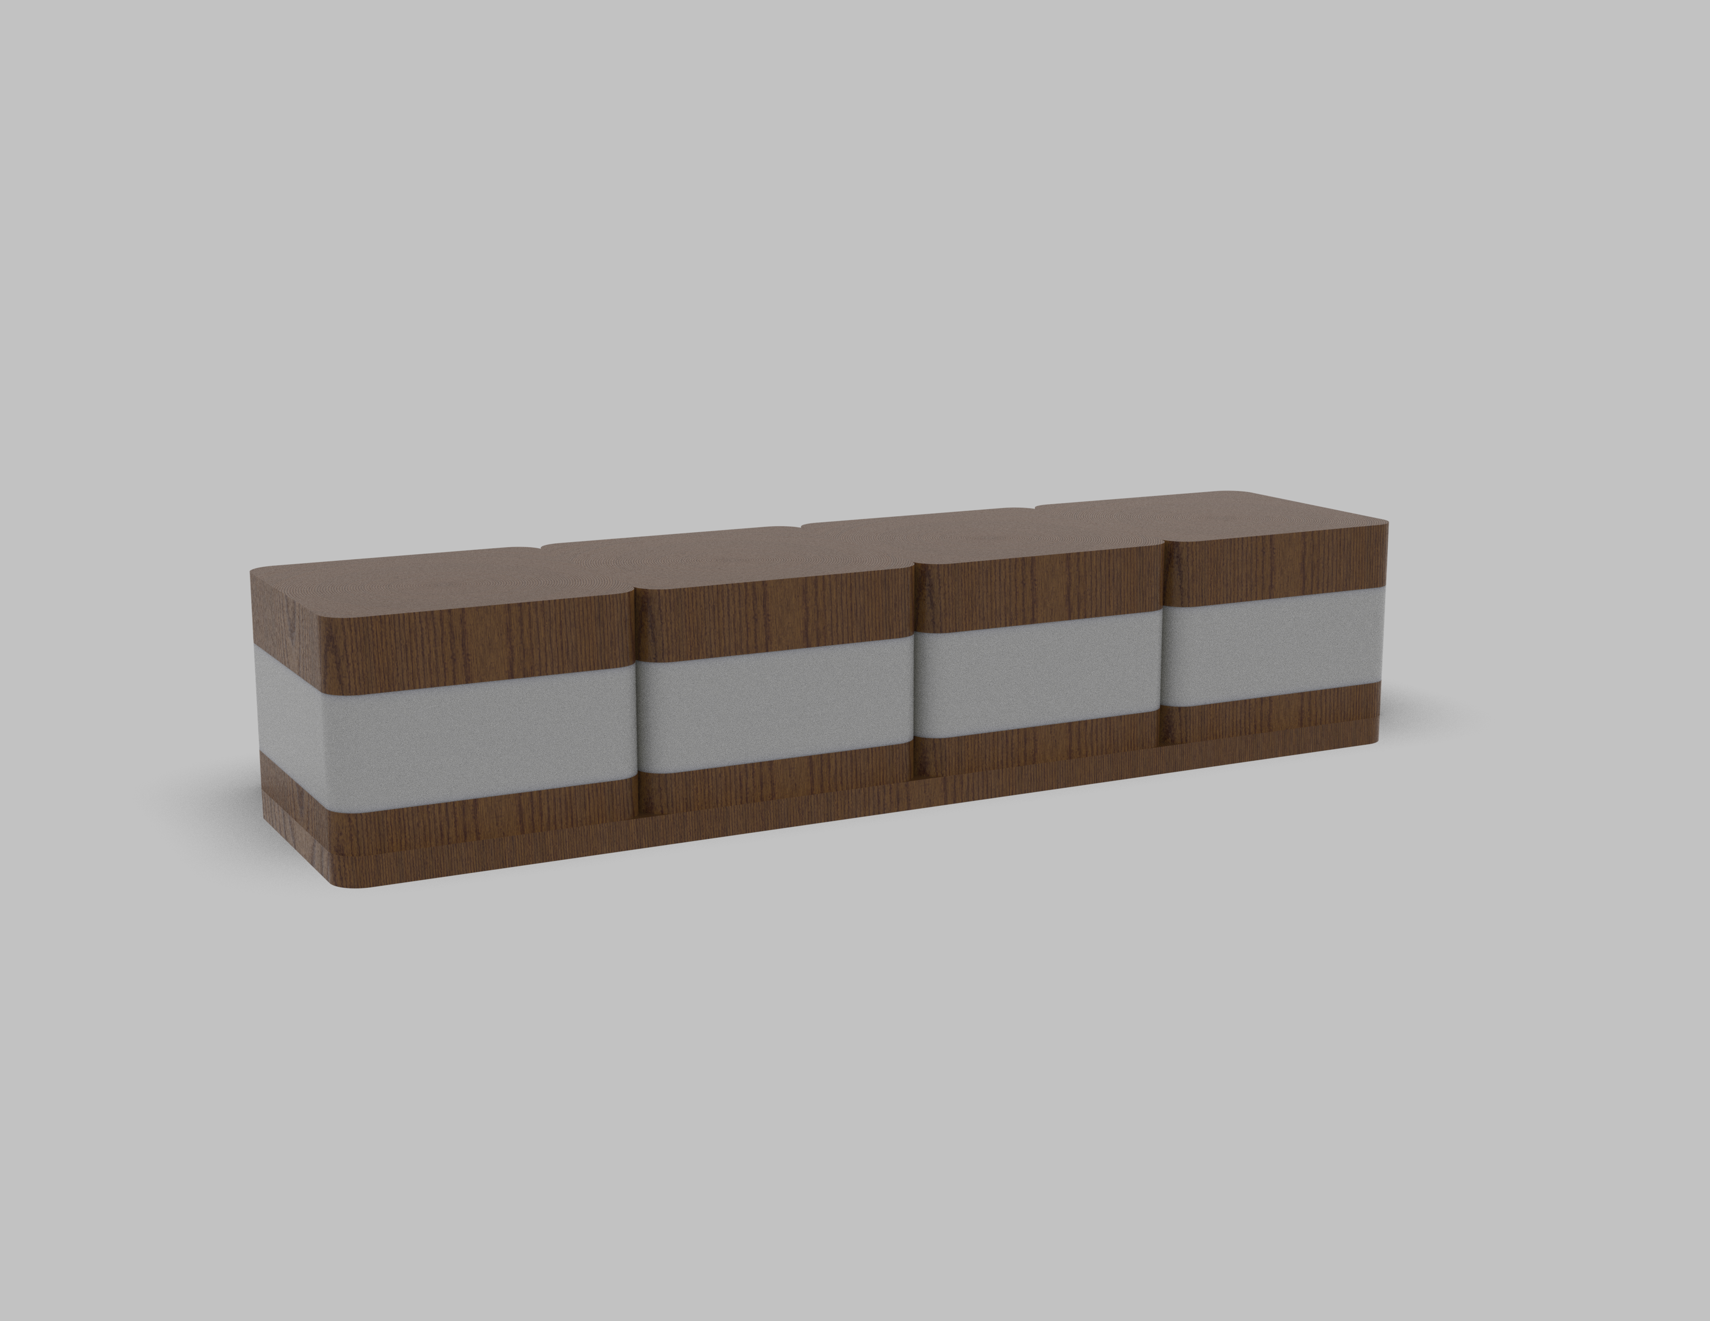
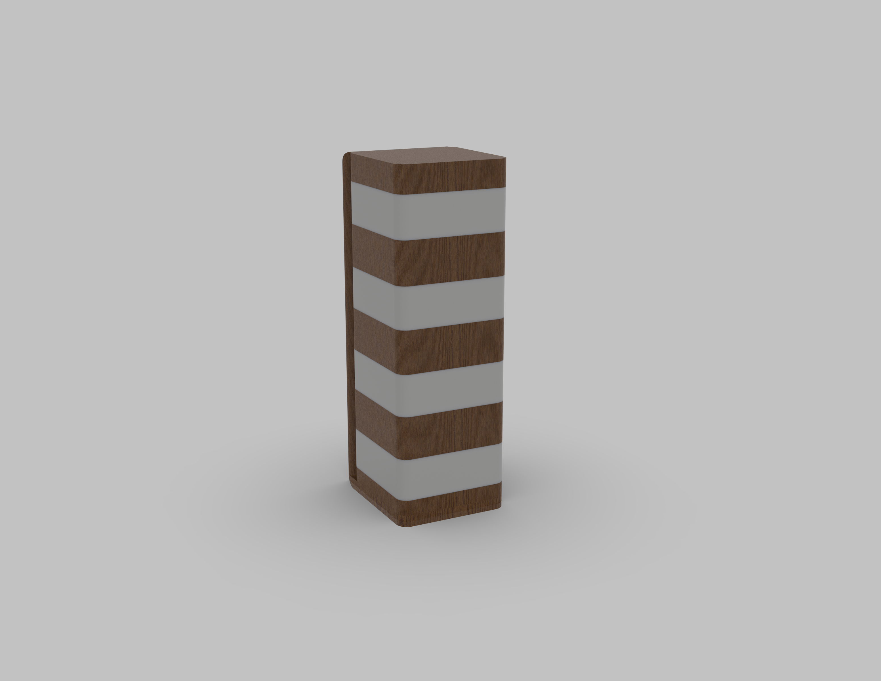
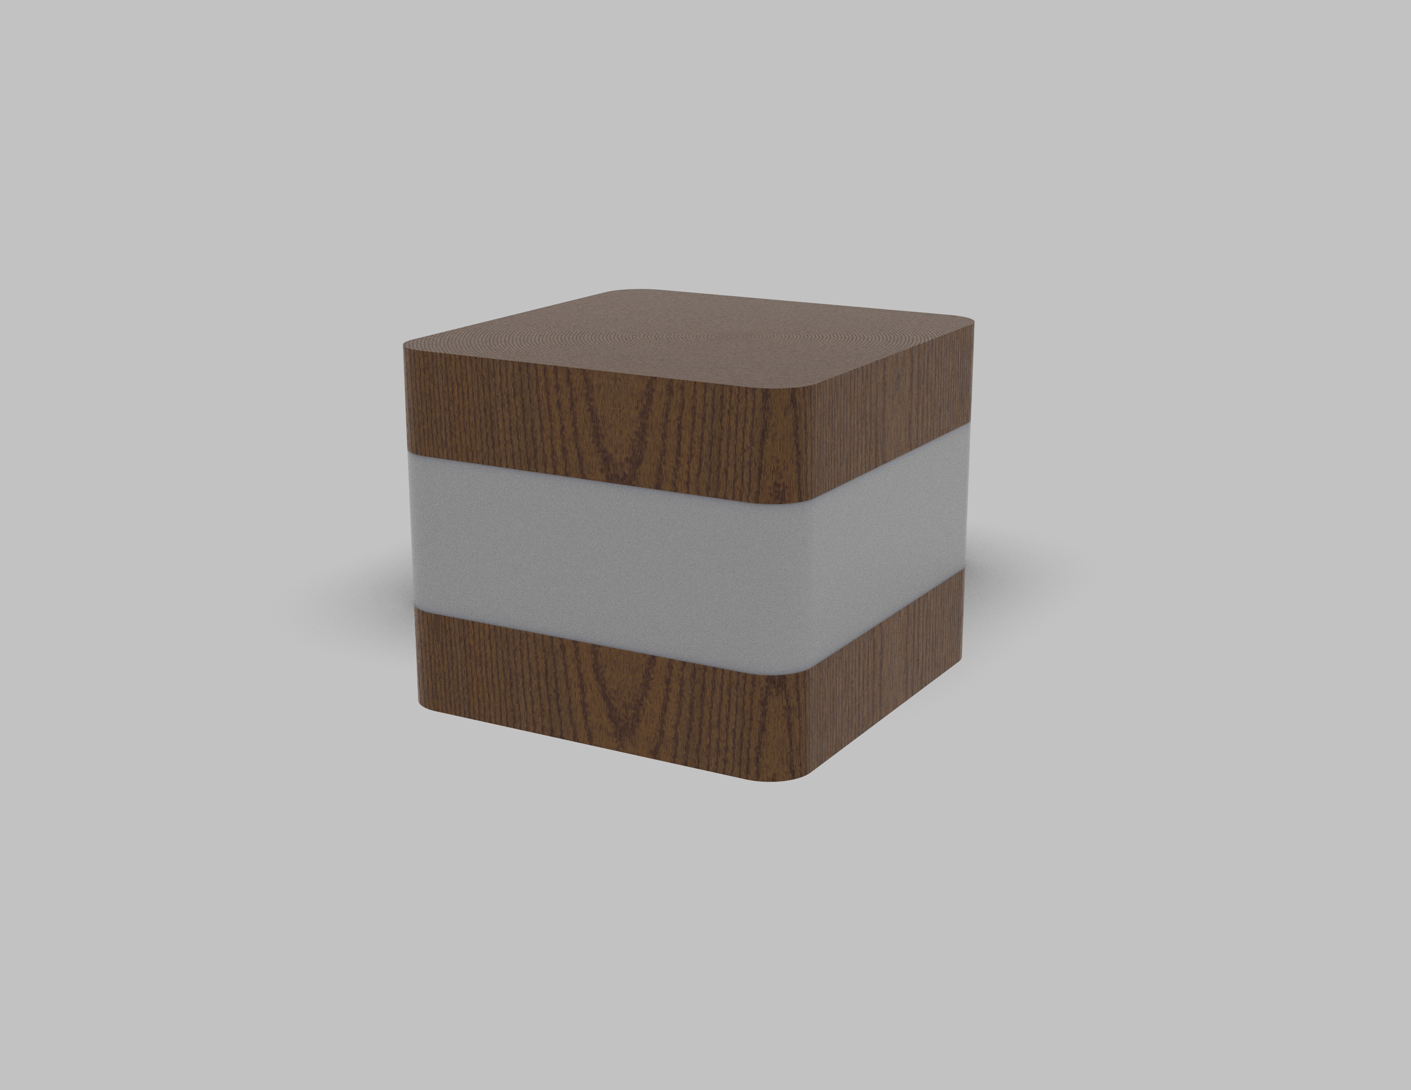
Design Philosophy and Form Finding
I wanted my design to prioritize seamless integration and intuitive interaction, ensuring that the technology enhances, rather than detracts from, the living space.
Minimalist Integration
Tangible Interaction
Finding a profile that mimics existing interior elements, blending seamlessly into any environment.
Eliminating traditional switches, physical docking acts as an intuitive trigger for illumination.
VL45 Radiohus Pendant
Orthogonal Scalability
what geometry allows linear scaling without gaps, forming cohesive light bars.

Slide 4
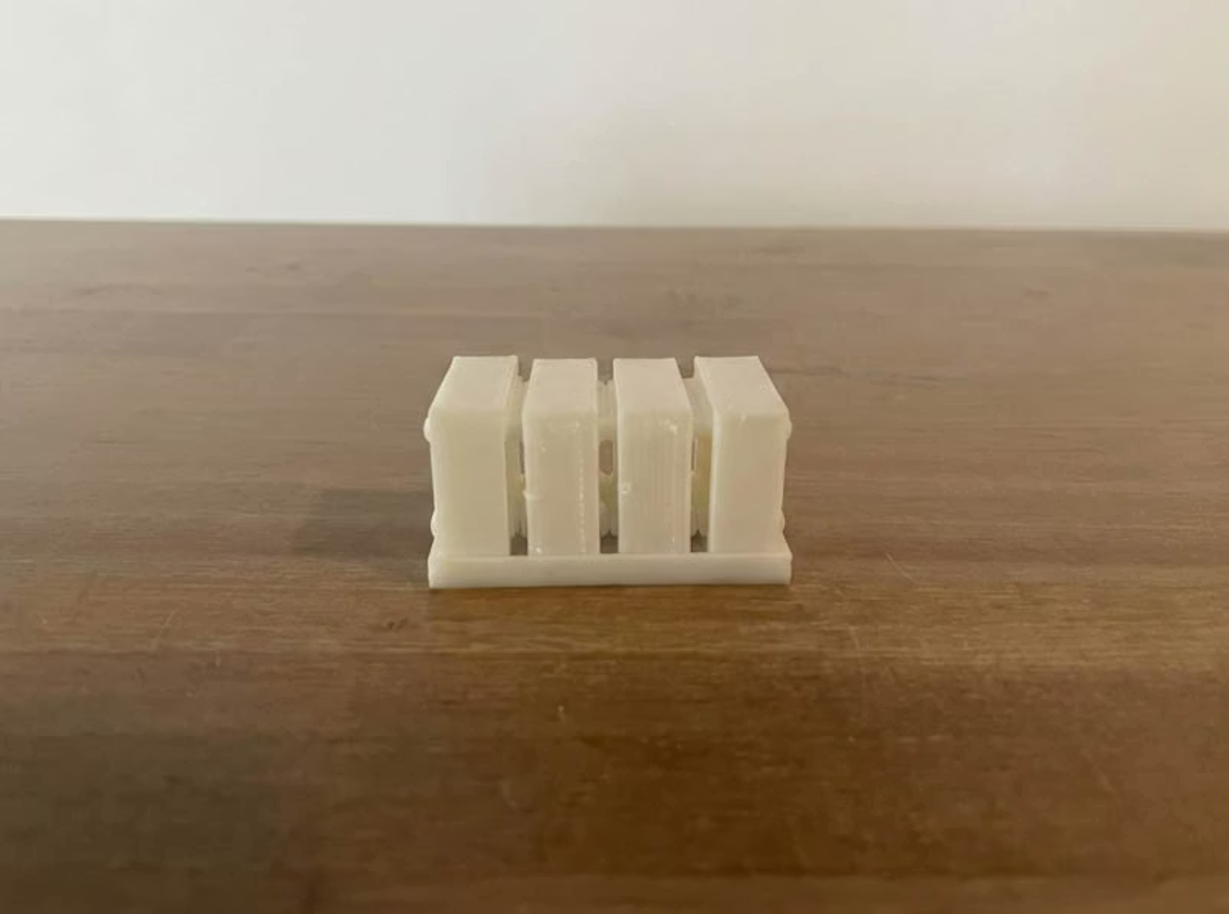
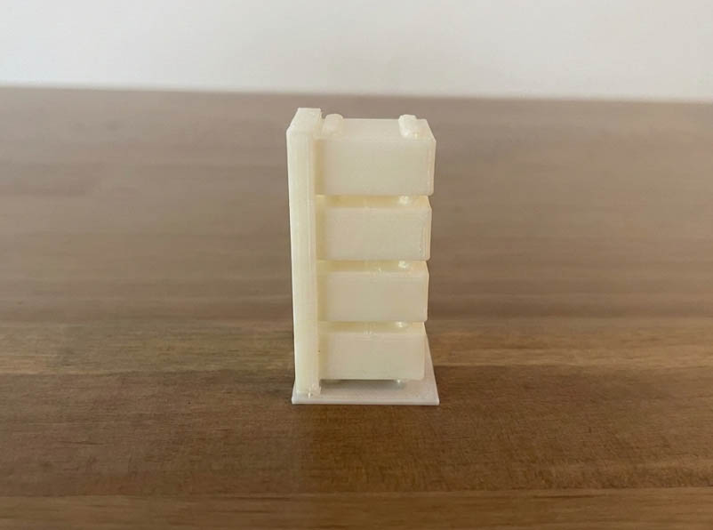
Form Factor
Docking
1
Perpendicular surfaces enable intuitive, gravity-assisted alignment without complex mechanical guides.
Scaling
2
Cubic geometry stacks seamlessly in arrays with minimal gaps or rotational complexity, forming cohesive light bars.
Manufacturing Simplicity
3
Orthogonal geometry reduces CNC toolpath complexity and minimizes material waste during subtractive manufacturing.
Production Scalability
4
Can this be made into a premium product that can be easily recreated?

Slide 5
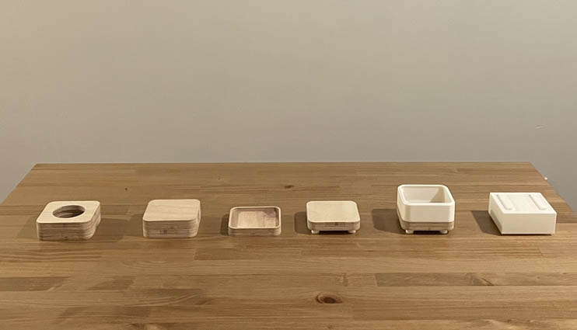
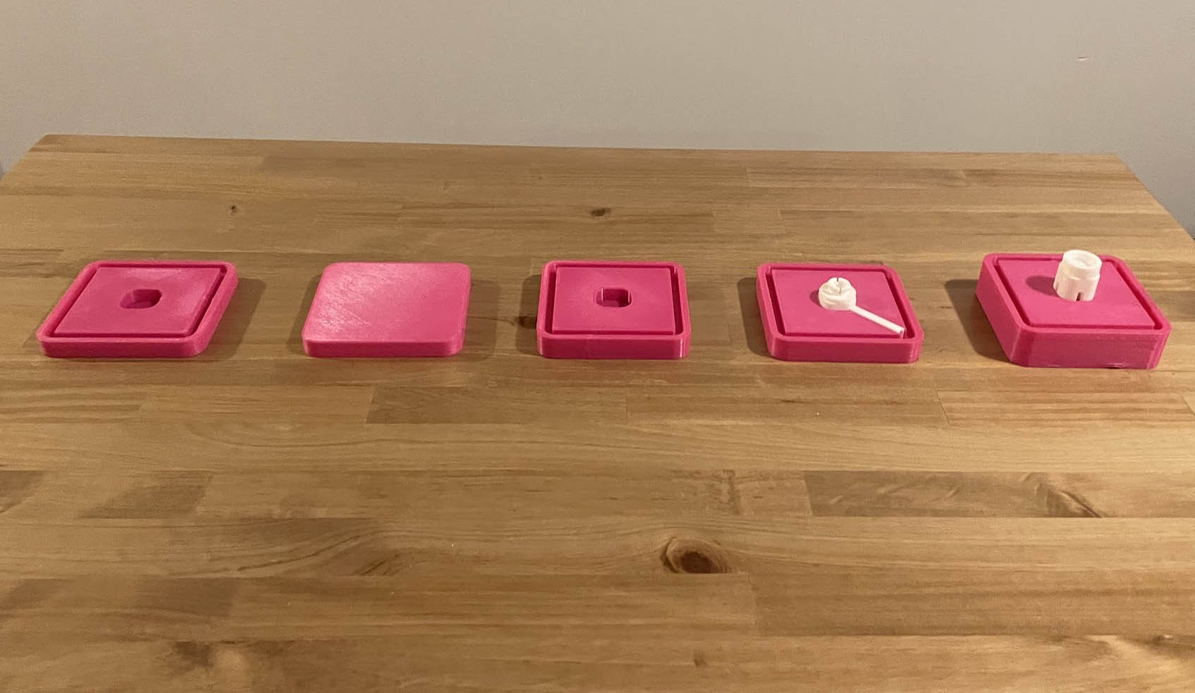
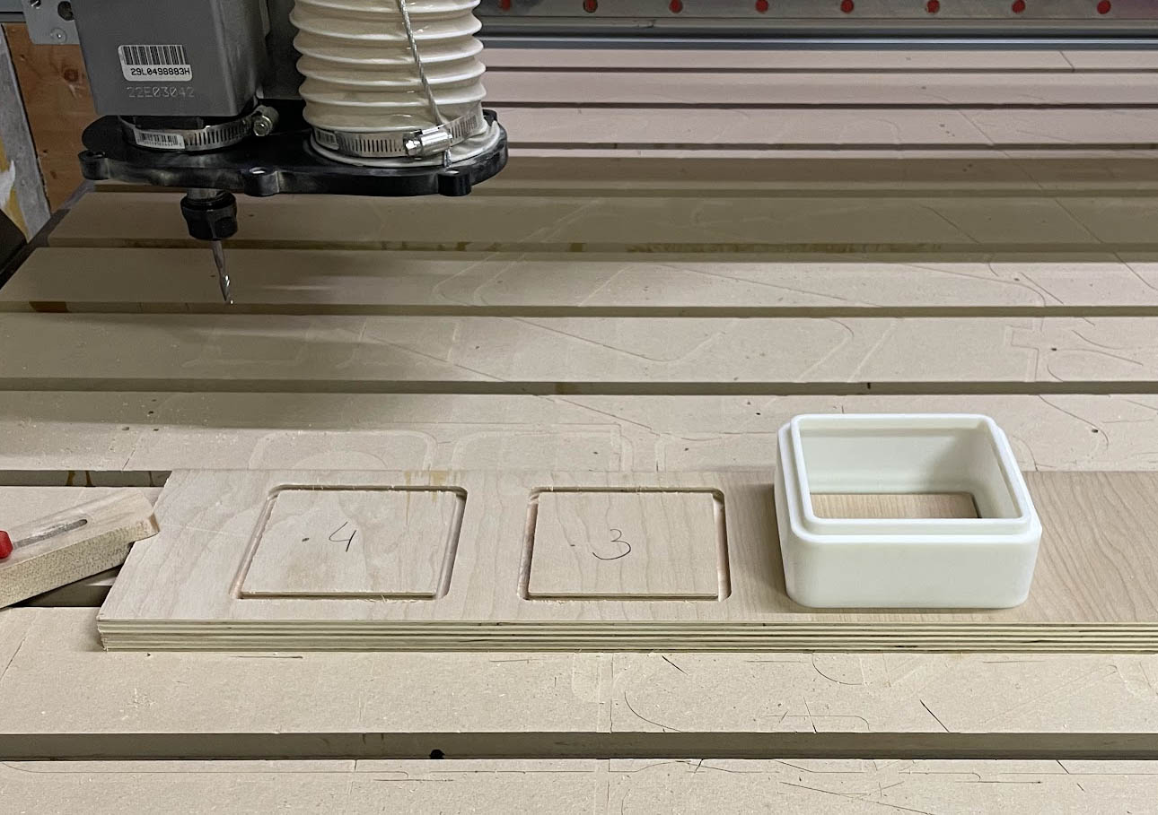
Form Validation
From miniature models to full-scale prototypes, I iterated and validated the sizing, optimal form, function, and ergonomic interaction.
Scaled Volumetric Analysis
Rapid additive manufacturing for immediate assessment of geometric proportions and stacking modularity.
Full-Scale Verification
PLA models validated physical presence and ergonomic interaction of the docking mechanism.
Tolerance Tuning
Iterative printing ensured internal void space was sufficient for electronics before final manufacturing.

Slide 6
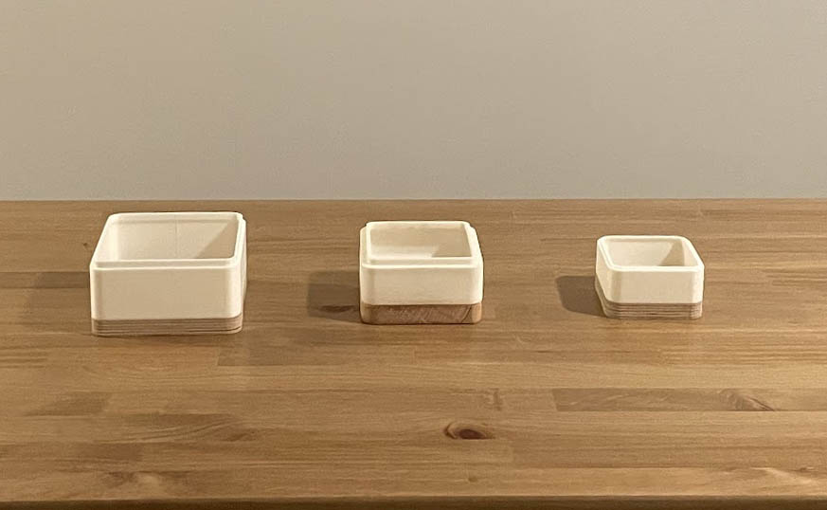
Sizing
Grip Dimensions
125 mm × 125 mm cube form factor optimised for single-handed movement. Proportions align with natural palm span and finger reach, enabling intuitive grasping without strain.

Slide 7


Contact-Based Power Architecture
The Docking Interface
Power transmission that relies on either spring-loaded pogo pin interface or magnetic field that establishes a zero-latency electrical connection immediately upon docking.
Distributed Ecosystem
A network of powered bases allows the optical unit to migrate seamlessly between single-point docks and linear multi-unit arrays without manual cable management.

Slide 8
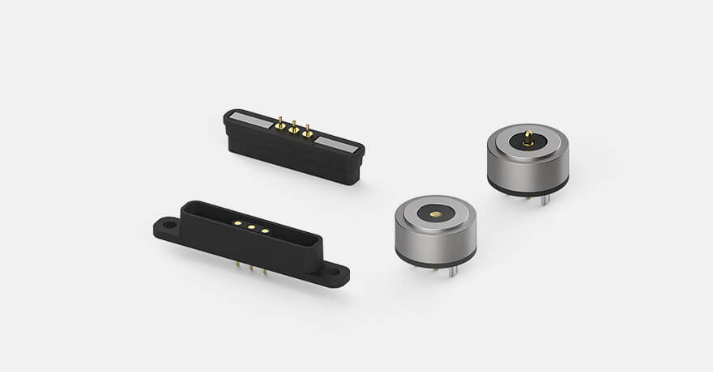
Pogo Pins
Spring-Loaded Contact
Springs provide consistent contact pressure and automatic electrical connection upon docking.
Cycle Life
Rated for thousands of dock/undock cycles, ensuring long-term reliability in frequent-use environments.
Magnetic Alignment Assistance
Integrated magnetic guides facilitate effortless alignment during docking, reducing user friction and improving connection reliability.

Slide 9
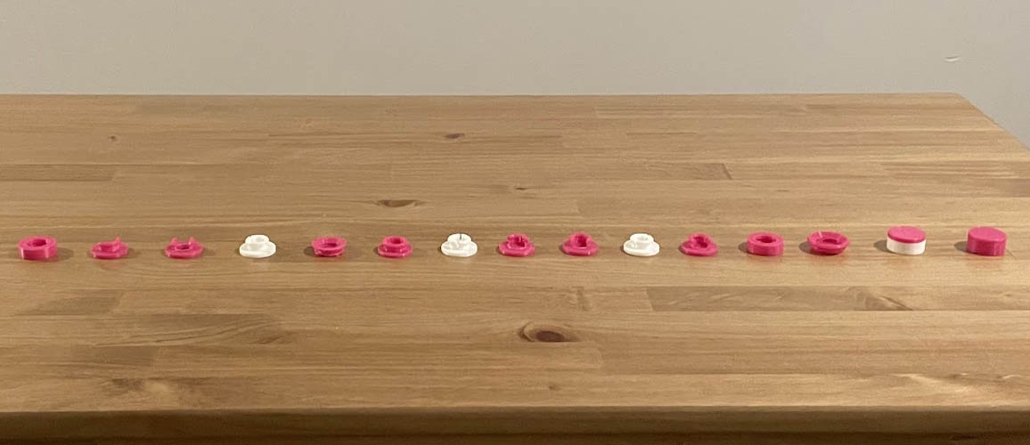
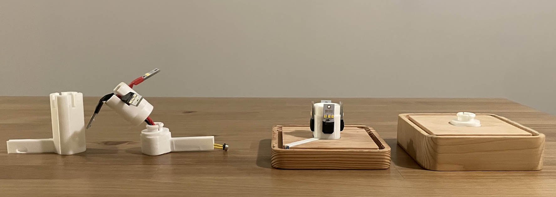
Internal Retention
The Serviceability Mandate
Rapid disassembly without visible screws or permanent adhesives to ensure longevity and repairability.
Industrial Inspiration
Iterative Tolerance Tuning
Research into architectural panel mounting systems led to the Fast mount friction-clip geometry as an ideal reference.
Extensive trial and error was required to custom 3D print a snap-fit equivalent, resulting in a reliable center-clip system.

Slide 10
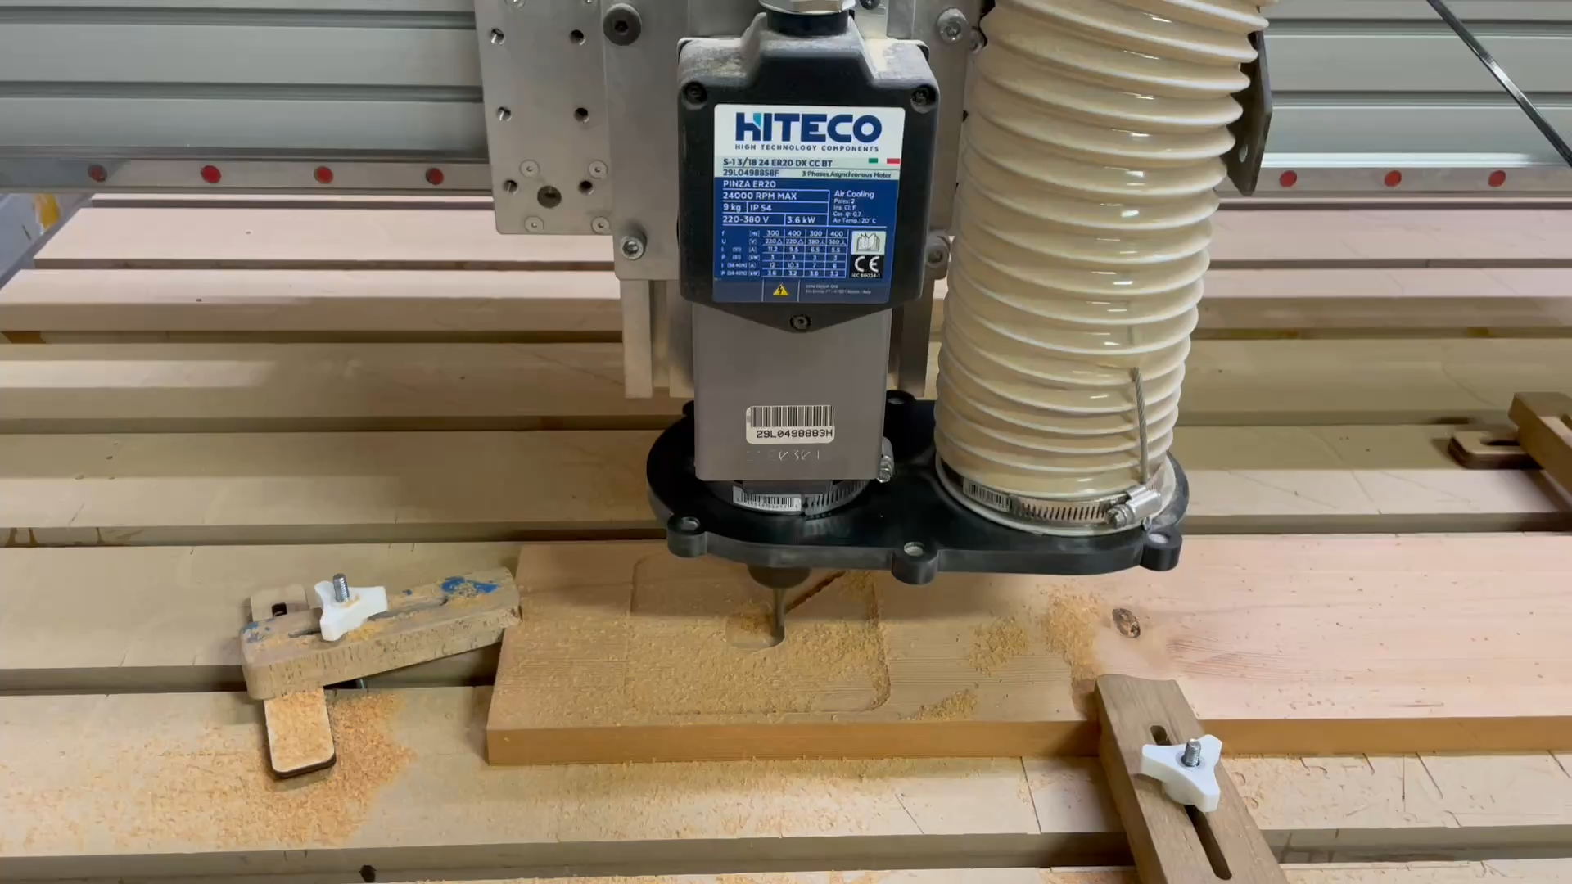
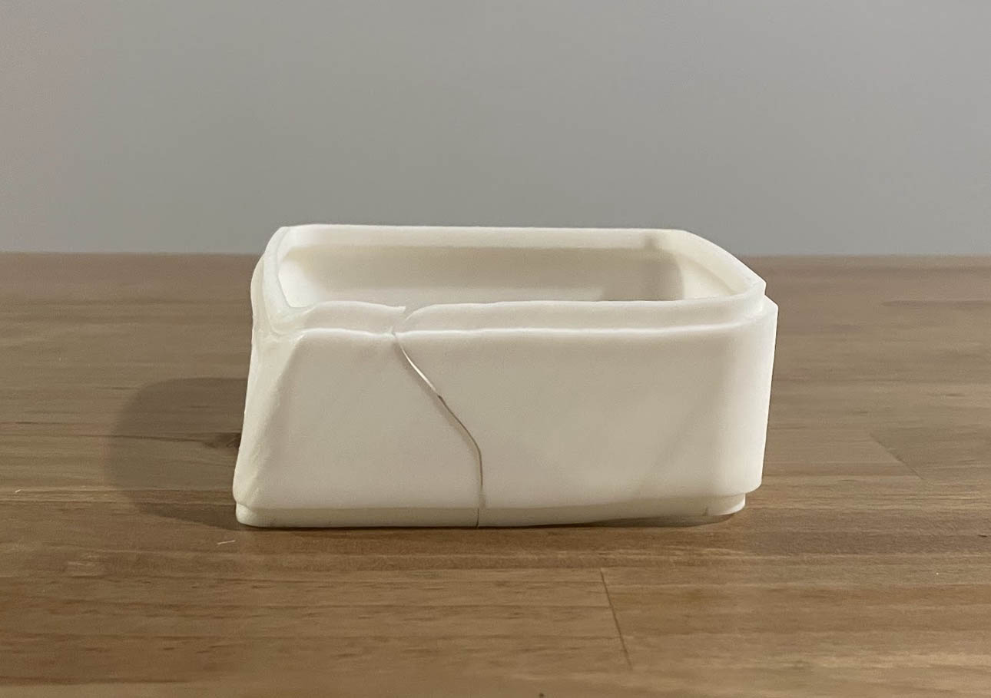
Materials and Machinery
Solid Wood
High-Fidelity Diffusion
Primary housing machined from Douglas Fir using a CNC router,
Central diffuser produced using Stereolithography (SLA)
resin printing for a smooth finish.

Slide 11
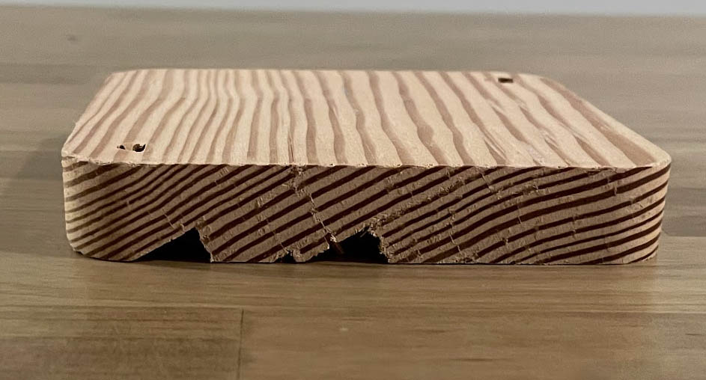
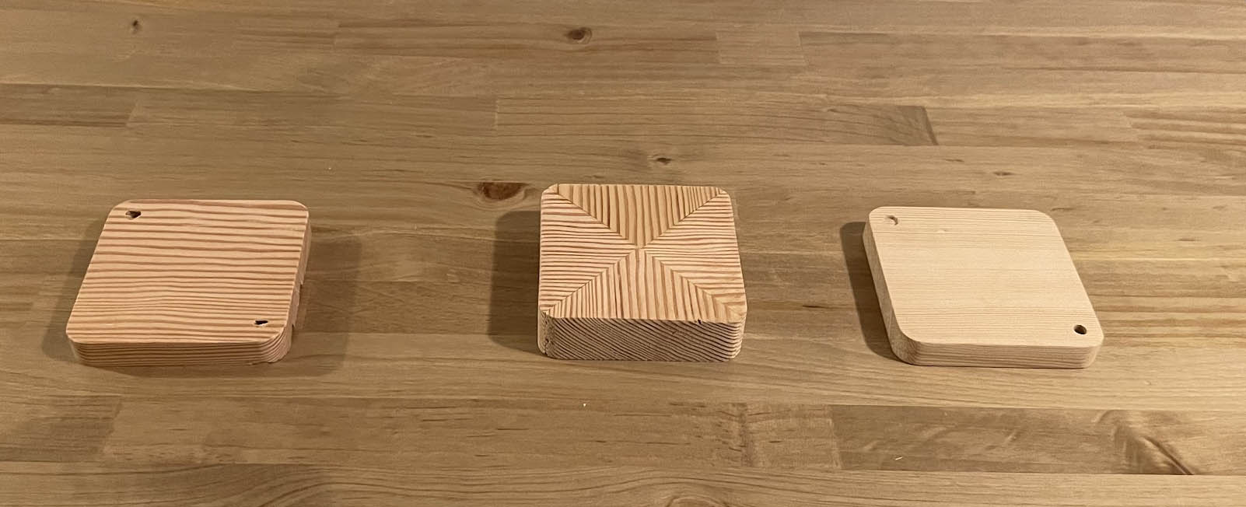
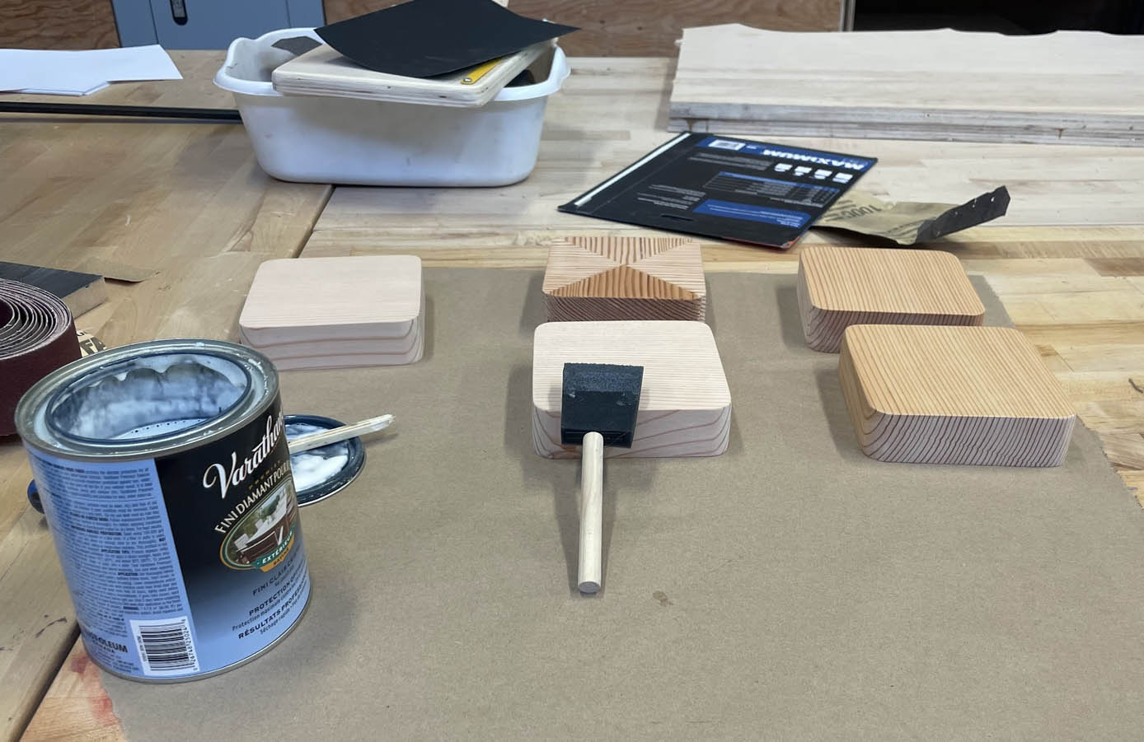
Process Optimization and Quality Control
Through rigorous testing and refinement, I identified and resolved critical manufacturing challenges to ensure product integrity and efficiency.
Material Stock Validation
Setup Reduction Strategy
Surface Treatment Protocols
Rigorous stock inspection is crucial due to the critical influence of undetected grain fractures in Douglas Fir.
Geometric design altered to utilize single-setup "through-bores" to eliminate misalignment from dual-sided machining.
I transitioned to thinner application layers and graduated sanding schedules to achieve a void-free surface.

Slide 12
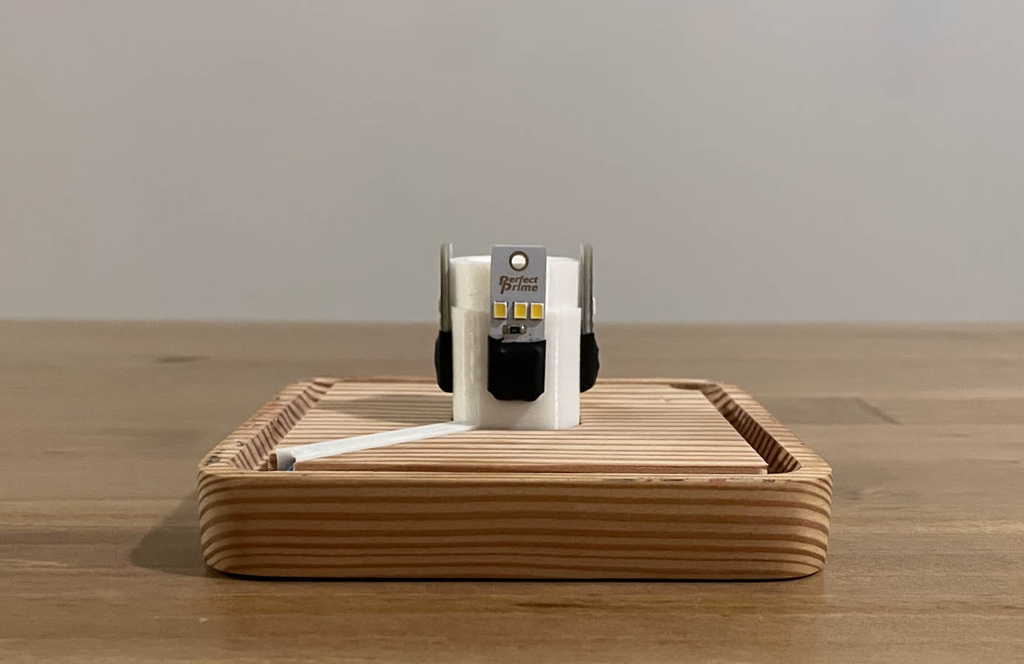
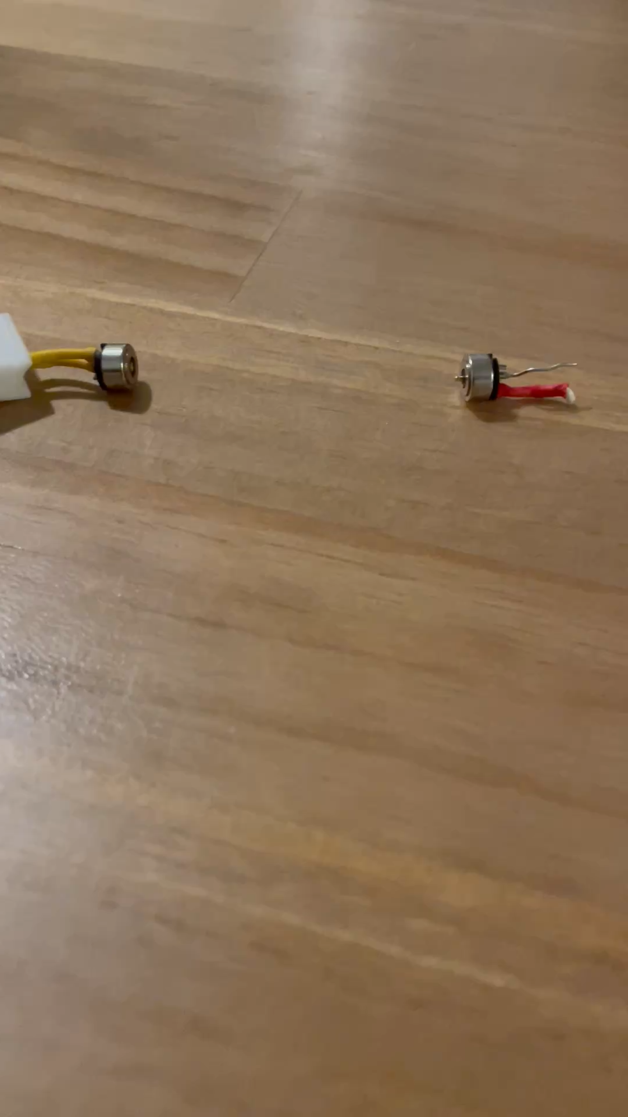
System Architecture
Universal Input Standard (USB-A)
The system utilises the industry-standard USB-A architecture.
Allows for versatile deployment using existing infrastructure: standard wall adaptors, laptops, or portable power banks for off-grid usage.
Human-Safe Voltage (SELV)
5V operation complies with SELV (Safety Extra Low Voltage) standards
Eliminates electrical hazard risks in residential and commercial environments
Internal Isolation
3D printed cable guides engineered within the wooden base
physically isolate wiring for electrical safety.

Slide 13
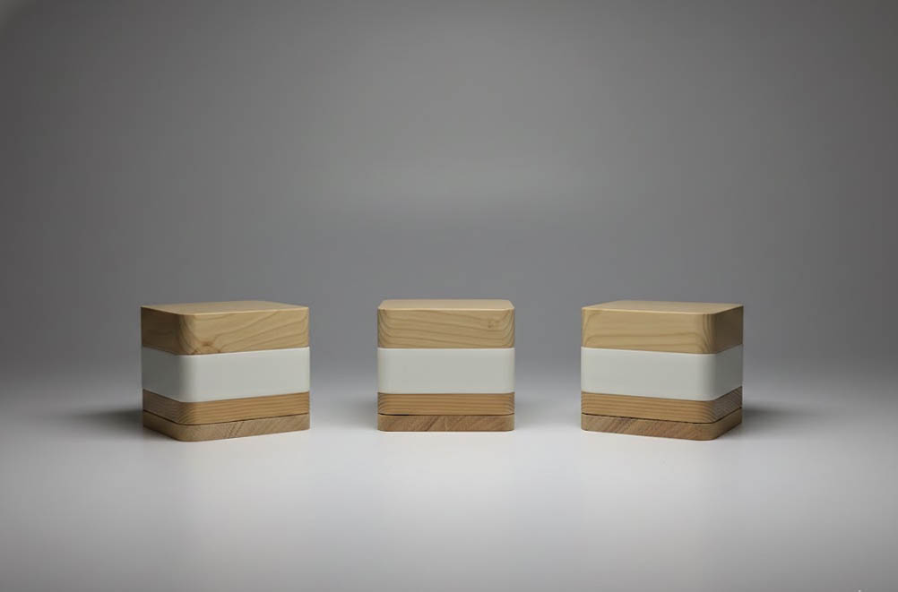
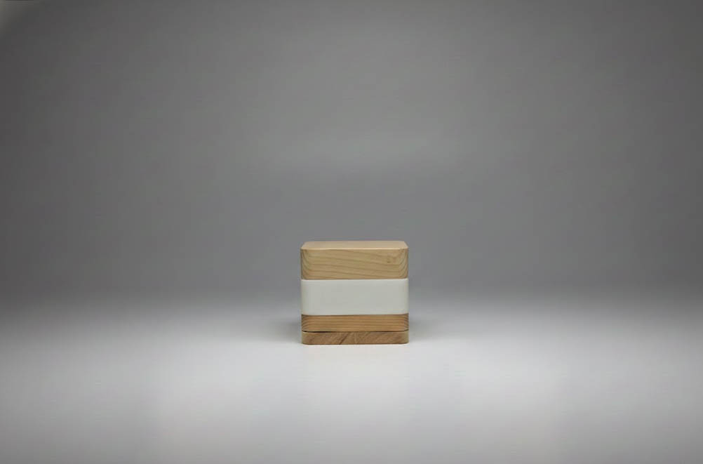
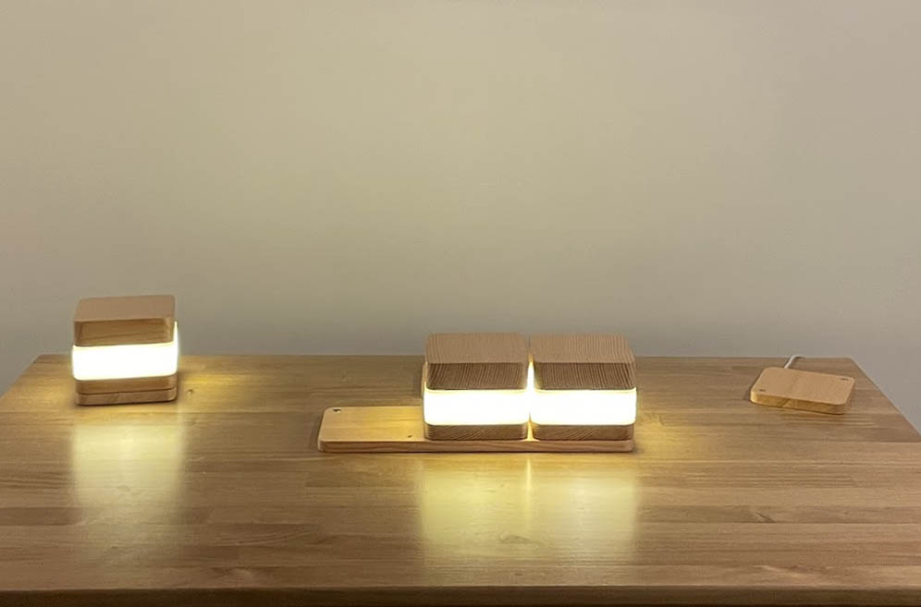
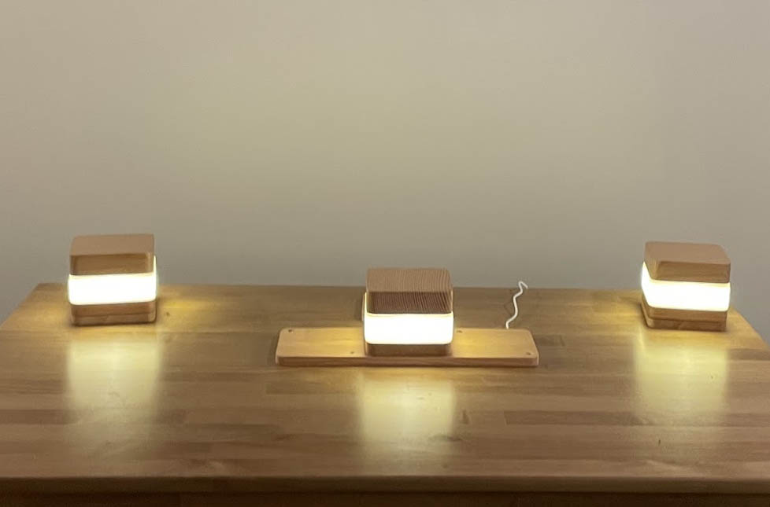

Slide 14
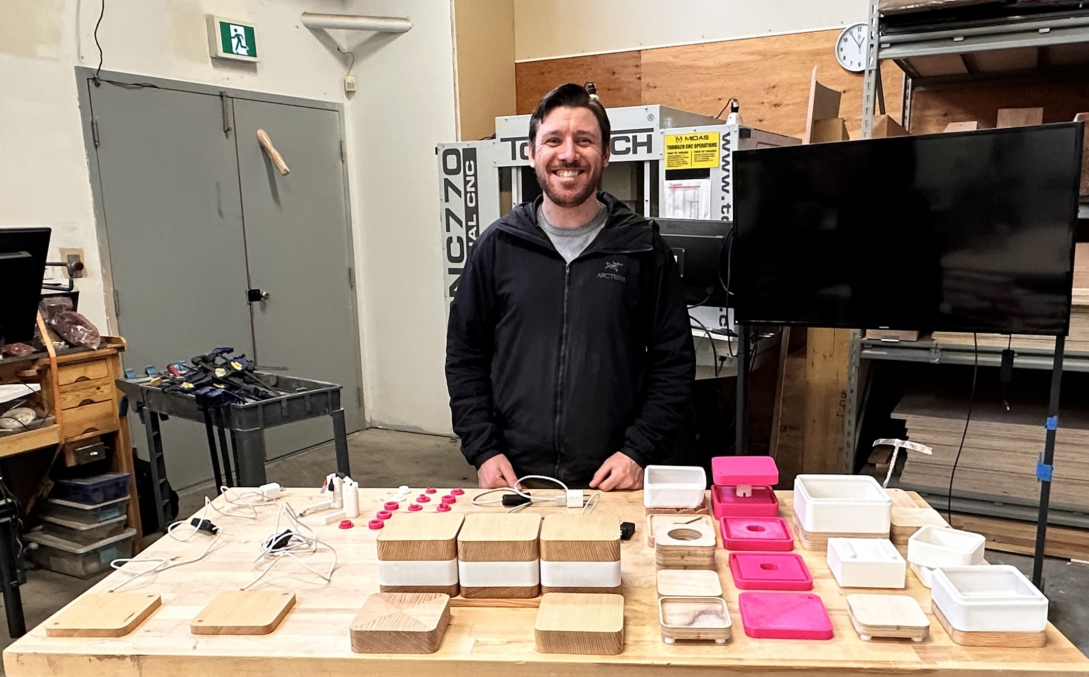
The End

